Slide 1


CS109B Recap
What have we learned, and where are we now?
Harvard IACS
CS109B
Pavlos Protopapas, Mark Glickman, and Chris Tanner

Slide 2
Your Data X
Given some data such that each row corresponds to a distinct i.i.d. observation
You may be interested in a particular column
Age
Play
Rainy
Temp
22
29
31
23
37
41
29
21
30
N
Y
N
Y
N
Y
Y
N
Y
Y
N
N
N
Y
N
Y
N
N
91
89
56
71
72
83
97
64
68

Slide 3
Your Data X
Given some data such that each row corresponds to a distinct i.i.d. observation
You may be interested in a particular column
Age
Play
Rainy
Temp
22
29
31
23
37
41
29
21
30
N
Y
N
Y
N
Y
Y
N
Y
Y
N
N
N
Y
N
Y
N
N
91
89
56
71
72
83
97
64
68

Slide 4
Your Data X
Given some data such that each row corresponds to a distinct i.i.d. observation
You may be interested in a particular column
Age
Play
Rainy
Temp
22
29
31
23
37
41
29
21
30
N
Y
N
Y
N
Y
Y
N
Y
Y
N
N
N
Y
N
Y
N
N
91
89
56
71
72
83
97
64
68

Slide 5
Your Data X
Given some data such that each row corresponds to a distinct i.i.d. observation
You may be interested in a particular column
Age
Play
Rainy
Temp
22
29
31
23
37
41
29
21
30
N
Y
N
Y
N
Y
Y
N
Y
Y
N
N
N
Y
N
Y
N
N
91
89
56
71
72
83
97
64
68

Slide 6
Your Data X
Given some data such that each row corresponds to a distinct i.i.d. observation
You may be interested in a particular column (e.g. Temp)
Age
Play
Rainy
Temp
22
29
31
23
37
41
29
21
30
N
Y
N
Y
N
Y
Y
N
Y
Y
N
N
N
Y
N
Y
N
N
91
89
56
71
72
83
97
64
68

Slide 7
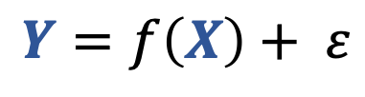
X
Y
Given some data such that each row corresponds to a distinct i.i.d. observation
You may be interested in a particular column (e.g. Temp)
Let’s divide our data and learn how data X is related to data Y
Assert that:
Age
Play
Rainy
Temp
22
29
31
23
37
41
29
21
30
N
Y
N
Y
N
Y
Y
N
Y
Y
N
N
N
Y
N
Y
N
N
91
89
56
71
72
83
97
64
68
$$Y=f\left(X\right)+ ε$$
Notes:
Y will represent our labelled data. Our gold truth.

Slide 8
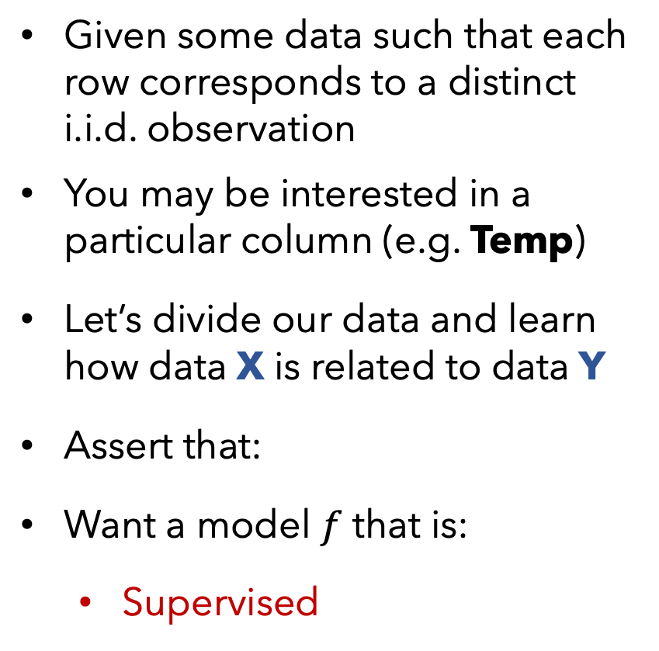
X
Y
Given some data such that each row corresponds to a distinct i.i.d. observation
You may be interested in a particular column (e.g. Temp)
Let’s divide our data and learn how data X is related to data Y
Assert that:
Want a model $f$ that is:
Supervised
Age
Play
Rainy
Temp
22
29
31
23
37
41
29
21
30
N
Y
N
Y
N
Y
Y
N
Y
Y
N
N
N
Y
N
Y
N
N
91
89
56
71
72
83
97
64
68
$$Y=f\left(X\right)+ ε$$

Slide 9

X
Y
Given some data such that each row corresponds to a distinct i.i.d. observation
You may be interested in a particular column (e.g. Temp)
Let’s divide our data and learn how data X is related to data Y
Assert that:
Want a model $f$that is:
Supervised
Age
Play
Rainy
Temp
22
29
31
23
37
41
29
21
30
N
Y
N
Y
N
Y
Y
N
Y
Y
N
N
N
Y
N
Y
N
N
91
89
56
71
72
83
97
64
68
$$Y=f\left(X\right)+ ε$$
Supervised

Slide 10
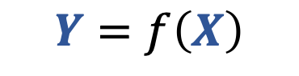
X
Y
Def:
Supervised models use target data, Y, to provide feedback so that your model can learn the relationship between X and Y.
Given some data such that each row corresponds to a distinct i.i.d. observation
You may be interested in a particular column (e.g. Temp)
Let’s divide our data and learn how data X is related to data Y
Assert that:
Want a model that is:
Supervised
Age
Play
Rainy
Temp
22
29
31
23
37
41
29
21
30
N
Y
N
Y
N
Y
Y
N
Y
Y
N
N
N
Y
N
Y
N
N
91
89
56
71
72
83
97
64
68
$$Y=f\left(X\right)+ ε$$
$$Y=f\left(X\right)$$
Supervised

Slide 11
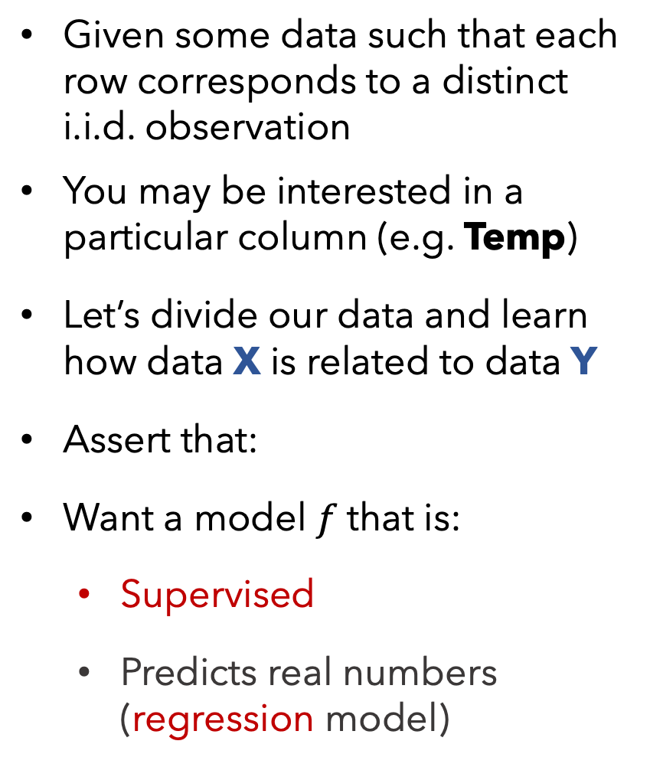
X
Y
Given some data such that each row corresponds to a distinct i.i.d. observation
You may be interested in a particular column (e.g. Temp)
Let’s divide our data and learn how data X is related to data Y
Assert that:
Want a model $f$that is:
Supervised
Predicts real numbers (regression model)
Age
Play
Rainy
Temp
22
29
31
23
37
41
29
21
30
N
Y
N
Y
N
Y
Y
N
Y
Y
N
N
N
Y
N
Y
N
N
91
89
56
71
72
83
97
64
68
$$Y=f\left(X\right)+ ε$$

Slide 12
X
Y
Given some data such that each row corresponds to a distinct i.i.d. observation
You may be interested in a particular column (e.g. Temp)
Let’s divide our data and learn how data X is related to data Y
Assert that:
Want a model that is:
Supervised
Predicts real numbers (regression model)
Age
Play
Rainy
Temp
Def:
Regression models are supervised models, whereby Y are continuous values.
22
29
31
23
37
41
29
21
30
N
Y
N
Y
N
Y
Y
N
Y
Y
N
N
N
Y
N
Y
N
N
91
89
56
71
72
83
97
64
68
$$Y=f\left(X\right)+ ε$$
regression model

Slide 13
X
Y
Given some data such that each row corresponds to a distinct i.i.d. observation
You may be interested in a particular column (e.g. Temp)
Let’s divide our data and learn how data X is related to data Y
Assert that:
Want a model that is:
Supervised
Predicts real numbers (regression model)
Age
Play
Rainy
Temp
Def:
Regression models are supervised models, whereby Y are continuous values.
Classification models are supervised models, whereby Y are categorical values.
22
29
31
23
37
41
29
21
30
N
Y
N
Y
N
Y
Y
N
Y
Y
N
N
N
Y
N
Y
N
N
91
89
56
71
72
83
97
64
68
$$Y=f\left(X\right)+ ε$$
regression model

Slide 14
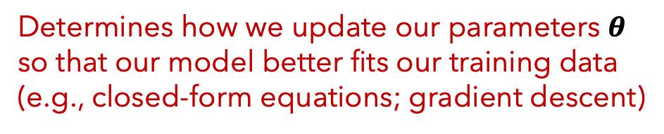
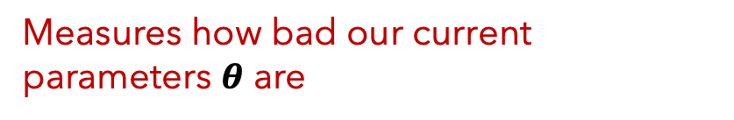
Supervised Models
IMPORTANT
When training any supervised model, be mindful of what you select for:
1. Our loss function (aka cost function)
Measures how bad our current parameters $θ$ are
2. Our optimization algorithm?
Determines how we update our parameters $θ$ so that our model better fits our training data
(e.g., closed-form equations; gradient descent)

Slide 15
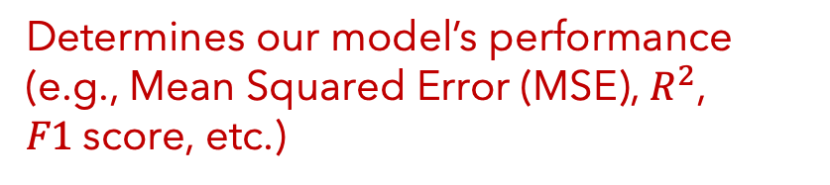
Supervised Models
IMPORTANT
When training any supervised model, be mindful of what you select for:
When testing your model’s predictions, be mindful of your metric selection:
1. Our loss function (aka cost function)
3. Our evaluation metric
Measures how bad our current parameters $θ$ are
Determines our model’s performance (e.g., Mean Squared Error (MSE), $R^{2}$, $F1$score, etc.)
2. Our optimization algorithm?
Determines how we update our parameters $θ$ so that our model better fits our training data
(e.g., closed-form equations; gradient descent)

Slide 16
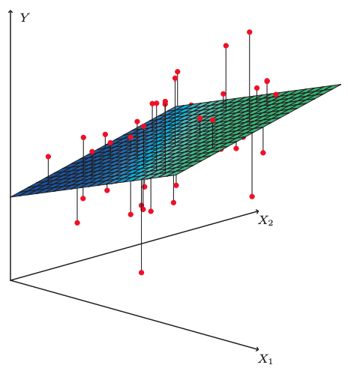
Linear Regression
Fitted model example
The plane is chosen to minimize the sum of the squared vertical distances (per our loss function, least squares) between each observation (red dots) and the plane.
Photo from ”An Introduction to Statistical Learning” (James, et al. 2017)

Slide 17

Linear Regression
PROS
CONS
Simple and fast approach to model linear relationships
Interpretable results via $θ$ ($β$coefficients)
Can’t model non-linear relationships
Vulnerable to outliers
Vulnerable to collinearity
Assumes error terms are uncorrelated*
* otherwise, we have false feedback during training

Slide 18
Supervised vs
Unsupervised
Regression vs Classification
Linear Regression
Supervised
Regression

Slide 19

X
Y
Returning to our data, let’s model Play instead of Temp
Again, we divide our data and learn how data X is related to data Y
Again, assert:
Age
Temp
Rainy
Play
22
29
31
23
37
41
29
21
30
91
89
56
71
72
83
97
64
68
Y
N
N
N
Y
N
Y
N
N
N
Y
N
Y
N
Y
Y
N
Y
$$Y=f\left(X\right)+ ε$$
Notes:
Y will represent our labelled data. Our gold truth.

Slide 20
X
Y
Returning to our data, let’s model Play instead of Temp
Again, we divide our data and learn how data X is related to data Y
Again, assert:
Want a model that is:
Supervised
Predicts categories/classes (classification model)
Q: What model could we use?
Age
Temp
Rainy
Play
22
29
31
23
37
41
29
21
30
91
89
56
71
72
83
97
64
68
Y
N
N
N
Y
N
Y
N
N
N
Y
N
Y
N
Y
Y
N
Y
$$Y=f\left(X\right)+ ε$$
Notes:
Y will represent our labelled data. Our gold truth.

Slide 21
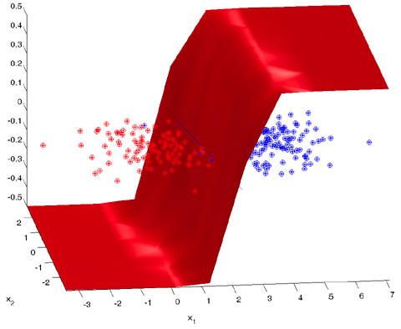
Logistic Regression
Fitted model example
The plane is chosen to minimize the error of our class probabilities (per our loss function, cross-entropy) and the true labels (mapped to 0 or 1)
Photo from http://strijov.com/sources/demoDataGen.php (Dr. Vadim Strijov)

Slide 22
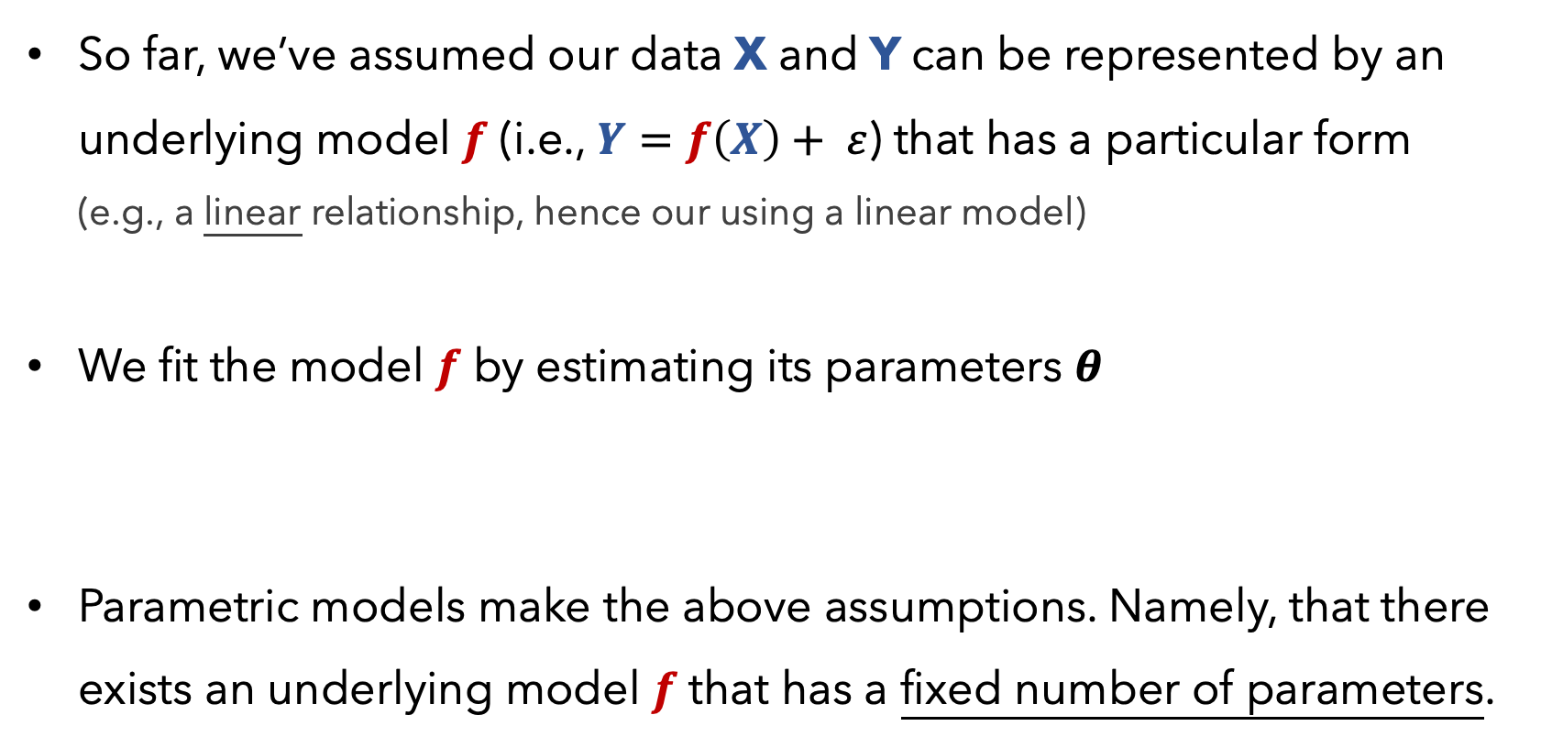
Parametric Models
So far, we’ve assumed our data X and Y can be represented by an underlying model $f$ (i.e., $Y=f\left(X\right)+ ε$) that has a particular form (e.g., a linear relationship, hence our using a linear model)
We fit the model $f$ by estimating its parameters $θ$
Parametric models make the above assumptions. Namely, that there exists an underlying model $f$ that has a fixed number of parameters.

Slide 23
Supervised vs
Unsupervised
Regression vs Classification
Parametric vs
Non-Parametric
Linear Regression
Logistic Regression
Supervised
Regression
Parametric
Supervised
Classification
Parametric

Slide 24
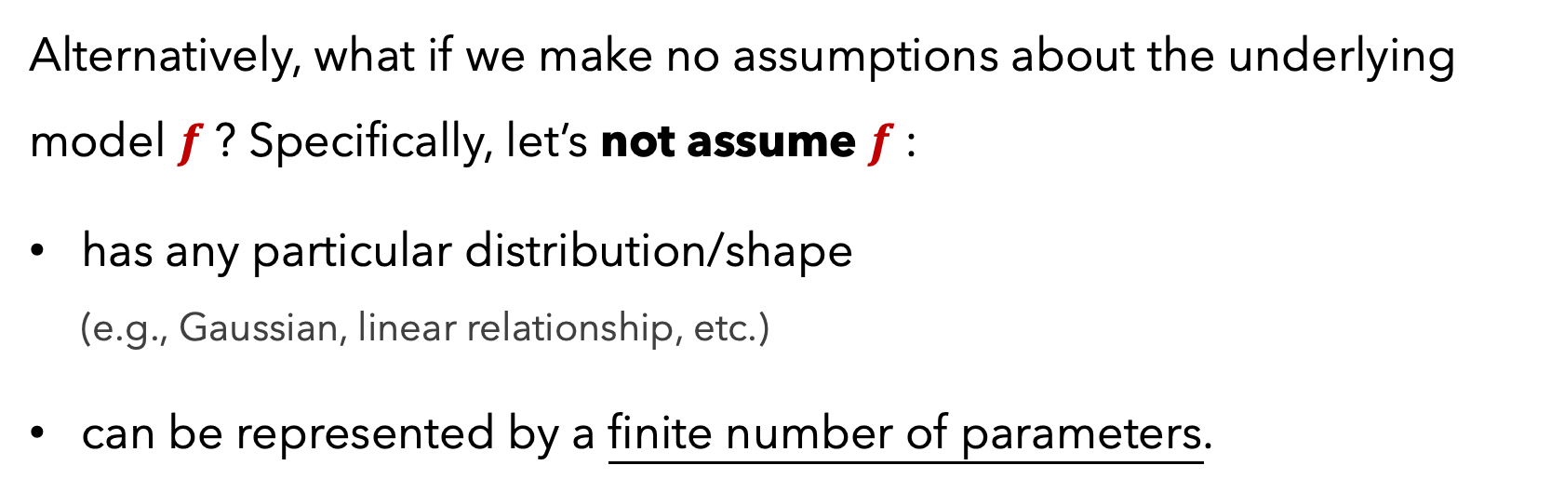
Non-Parametric Models
Alternatively, what if we make no assumptions about the underlying model $f$? Specifically, let’s not assume $f$:
has any particular distribution/shape (e.g., Gaussian, linear relationship, etc.)
can be represented by a finite number of parameters.
This would constitute a non-parametric model.

Slide 25
Non-Parametric Models
Non-parametric models are allowed to have parameters; in fact, oftentimes the # of parameters grows as our amount of training data increases
Since they make no strong assumptions about the form of the function/model, they are free to learn any functional form from the training data -- infinitely complex.

Slide 26
X
Y
Returning to our data, let’s again predict if a person will Play
If we do not want to assume any particular form about how X and Y relate, we could use a different supervised model
Suppose we do not care to build a decision boundary but merely want to make predictions based on similar data that we saw during training
Age
Temp
Rainy
Play
22
29
31
23
37
41
29
21
30
91
89
56
71
72
83
97
64
68
Y
N
N
N
Y
N
Y
N
N
N
Y
N
Y
N
Y
Y
N
Y

Slide 27
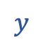

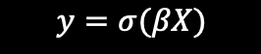



k-NN
Refresher:
k-NN doesn’t train a model
One merely specifies a $k$ value
At test time, a new piece of data $a$:
must be compared to all other training data $b$, to determine its k-nearest neighbors, per some distance metric $d\left(a,b\right)$
is classified as being the majority class (if categorical) or average (if quantitative) of its k-neighbors
N
$$y$$
$$y=σ(βX)$$
22
91
Y
$$x_{1}$$
$$x_{2}$$
$$x_{3}$$
Mathematically

Slide 28
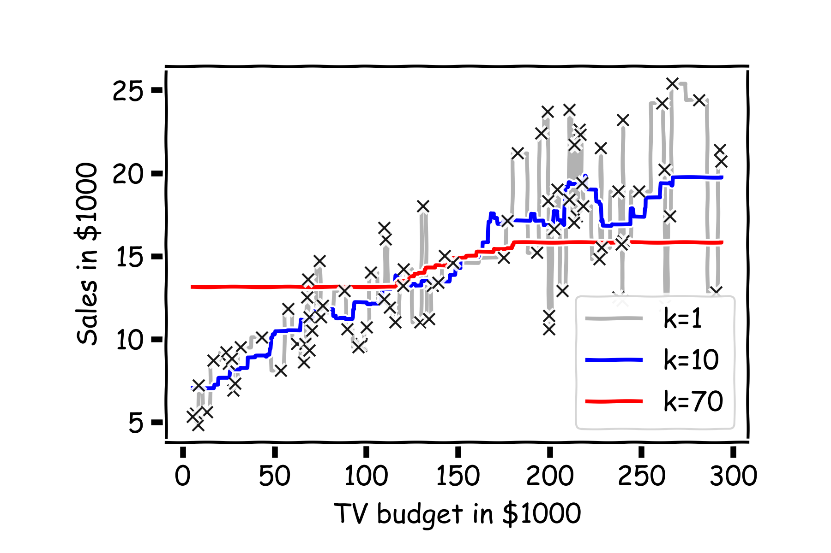
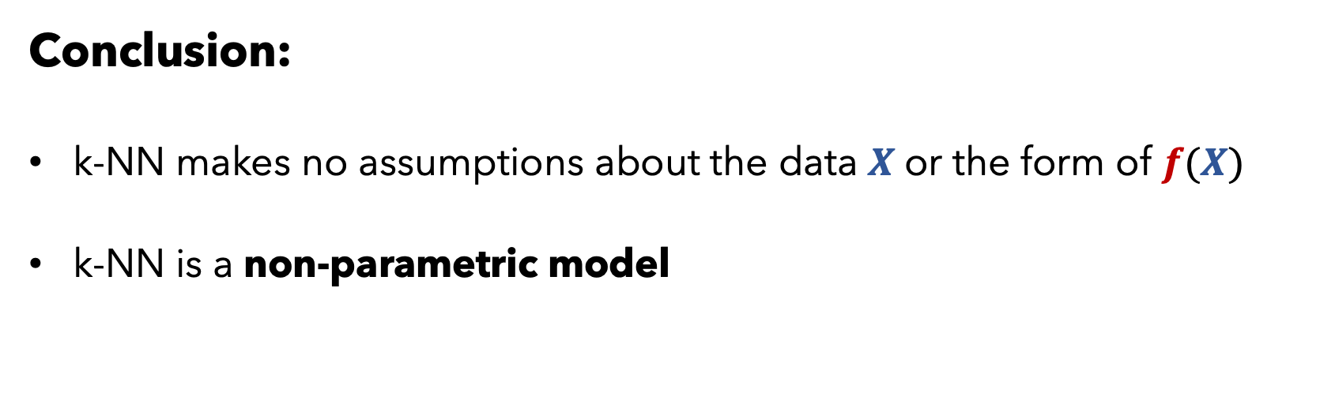
k-NN
Conclusion:
k-NN makes no assumptions about the data $X$or the form of $f(X)$
k-NN is a non-parametric model

Slide 29
k-NN
PROS
CONS
Intuitive and simple approach
Can model any type of data / places no assumptions on the data
Fairly robust to missing data
Good for highly sparse data (e.g., user data, where the columns are thousands of potential items of interest)
Can be very computationally expensive if the data is large or high-dimensional
Should carefully think about features, including scaling them
Mixing quantitative and categorical data can be tricky
Interpretation isn’t meaningful
Often, regression models are better, especially with little data

Slide 30
Supervised vs
Unsupervised
Regression vs Classification
Parametric vs
Non-Parametric
Linear Regression
Logistic Regression
k-NN
Supervised
Regression
Parametric
Supervised
Classification
Parametric
Supervised
either
Non-Parametric

Slide 31
X
Y
Returning to our data yet again, let’s predict if a person will Play
If we do not want to assume any particular form about how X and Y relate, believing that no single equation can model the possibly non-linear relationship
Suppose we just want our model to have robust decision boundaries with interpretable results
Age
Temp
Rainy
Play
22
29
31
23
37
41
29
21
30
91
89
56
71
72
83
97
64
68
Y
N
N
N
Y
N
Y
N
N
N
Y
N
Y
N
Y
Y
N
Y

Slide 32
Decision Tree
Refresher:
A Decision Tree iteratively determines how to split our data by the best feature value so as to minimize the entropy (uncertainty) of our resulting sets.
Must specify the:
Splitting criterion (e.g., Gini index, Information Gain)
Stopping criterion (e.g., tree depth, Information Gain Threshold)

Slide 33
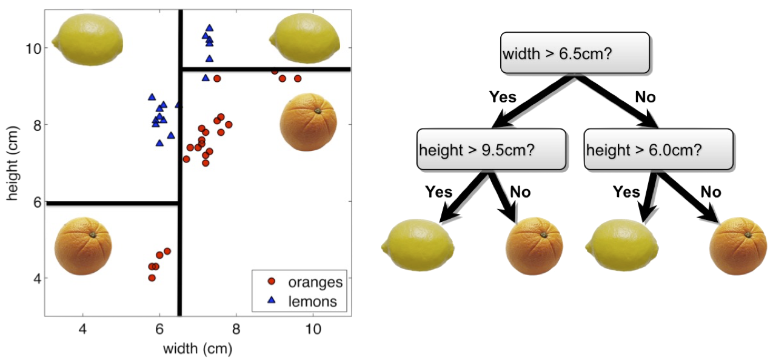
Decision Tree
Refresher: Each comparison and branching represents splitting a region in the feature space on a single feature. Typically, at each iteration, we split once along one dimension (one predictor).

Slide 34
Decision Tree
A Decision Tree makes no distributional assumptions about the data.
The number of parameters / shape of the tree depends entirely on the data (i.e., imagine data that is perfectly separable into disjoint sections by features, vs data that is highly complex with overlapping values)
Decision Trees make use of the full data (X and Y) and can handle Y values that are categorical or quantitative

Slide 35
Supervised vs
Unsupervised
Regression vs Classification
Parametric vs
Non-Parametric
Linear Regression
Logistic Regression
k-NN
Decision Tree
Supervised
Regression
Parametric
Supervised
Classification
Parametric
Supervised
either
Non-Parametric
Supervised
either
Non-Parametric

Slide 36
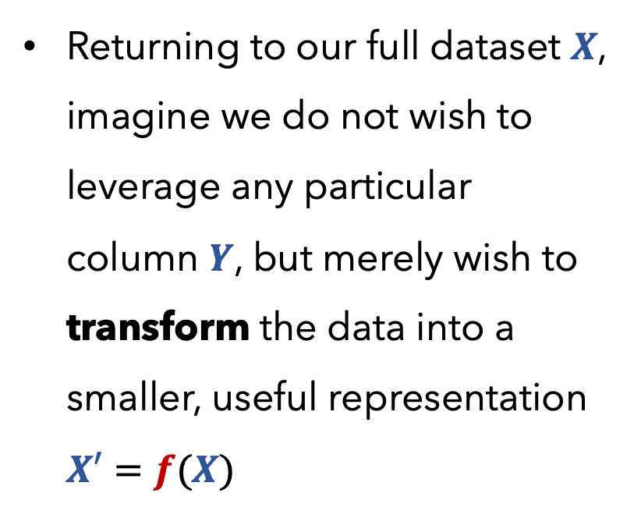
Your Data X
Returning to our full dataset $X$, imagine we do not wish to leverage any particular column $Y$, but merely wish to transform the data into a smaller, useful representation $X′=f(X)$
Age
Play
Rainy
Temp
22
29
31
23
37
41
29
21
30
N
Y
N
Y
N
Y
Y
N
Y
Y
N
N
N
Y
N
Y
N
N
91
89
56
71
72
83
97
64
68

Slide 37
Principal Component Analysis (PCA)
Refresher:
PCA isn’t a model per se but is a procedure/technique to transform data, which may have correlated features, into a new, smaller set of uncorrelated features
These new features, by design, are a linear combination of the original features that capture the most variance
Often useful to perform PCA on data before using models that explicitly use data values and distances between them (e.g., clustering)

Slide 38
Supervised vs
Unsupervised
Regression vs Classification
Parametric vs
Non-Parametric
Linear Regression
Logistic Regression
k-NN
Decision Tree
PCA
Supervised
Regression
Parametric
Supervised
Classification
Parametric
Supervised
either
Non-Parametric
Supervised
either
Non-Parametric
Unsupervised
neither
Non-Parametric

Slide 39
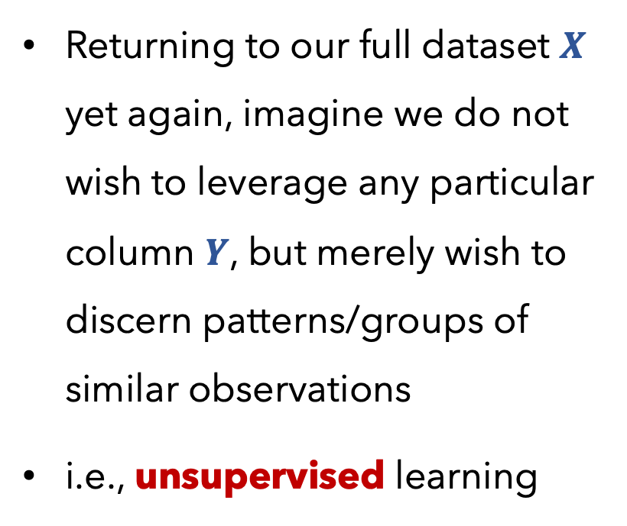
Your Data X
Returning to our full dataset $X$ yet again, imagine we do not wish to leverage any particular column $Y$, but merely wish to discern patterns/groups of similar observations
i.e., unsupervised learning
Age
Play
Rainy
Temp
22
29
31
23
37
41
29
21
30
N
Y
N
Y
N
Y
Y
N
Y
Y
N
N
N
Y
N
Y
N
N
91
89
56
71
72
83
97
64
68

Slide 40
Clustering
Refresher:
There are many approaches to clustering (e.g., k-Means, hierarchical, DBScan)
Regardless of the approach, we need to specify a distance metric (e.g., Euclidean, Manhattan)
Performance: we can measure the intra-cluster and outer-cluster fit (i.e., silhouette score), along with an estimate that compares our clustering to the situation had our data been randomly generated (gap statistic)

Slide 41
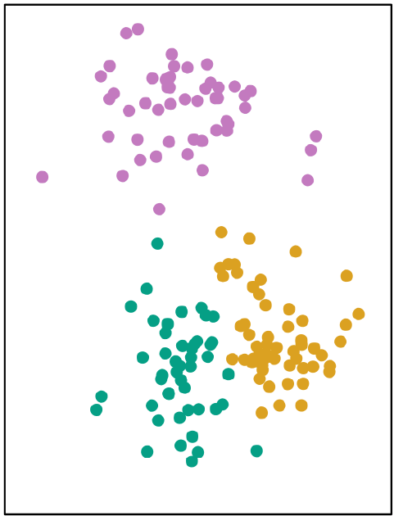
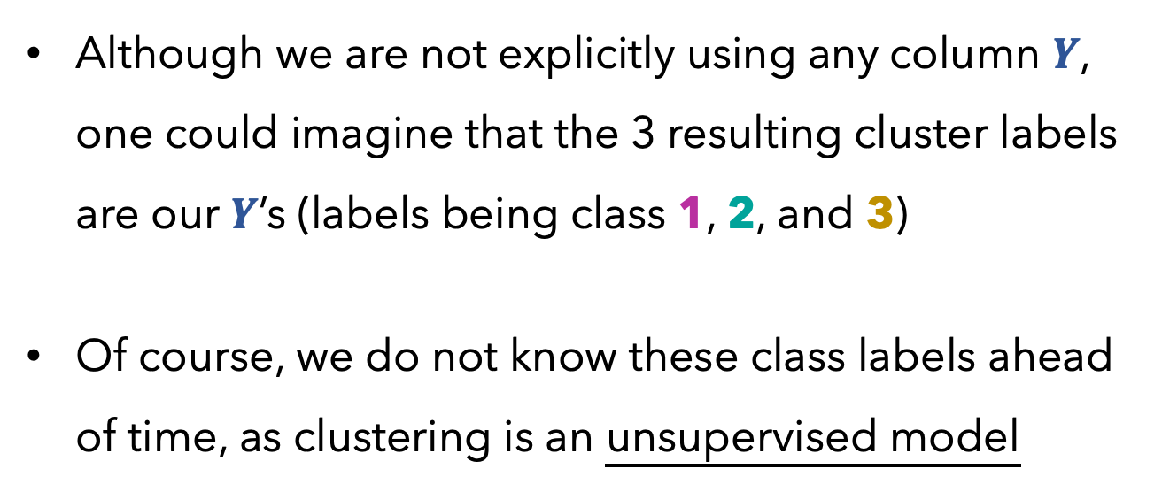
Clustering
k-Means example:
Although we are not explicitly using any column $Y$, one could imagine that the 3 resulting cluster labels are our $Y$’s (labels being class 1, 2, and 3)
Of course, we do not know these class labels ahead of time, as clustering is an unsupervised model
Visual Representation

Slide 42
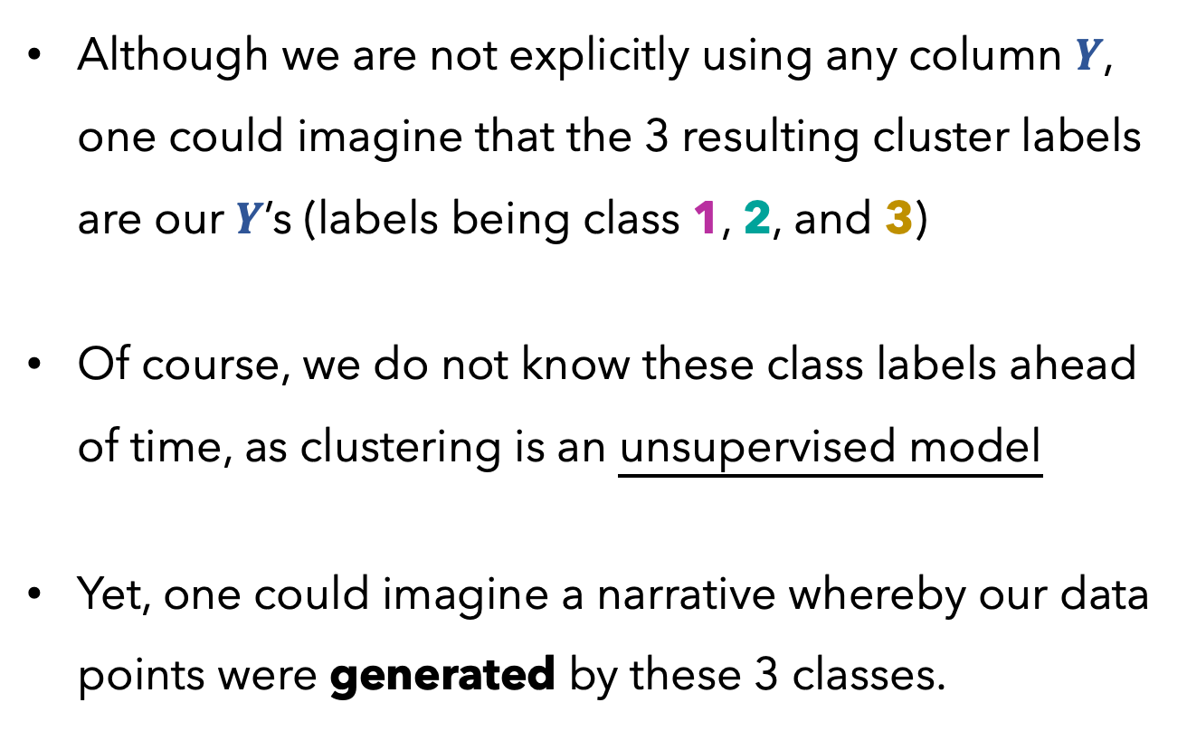
Clustering
k-Means example:
Although we are not explicitly using any column $Y$, one could imagine that the 3 resulting cluster labels are our $Y$’s (labels being class 1, 2, and 3)
Of course, we do not know these class labels ahead of time, as clustering is an unsupervised model
Yet, one could imagine a narrative whereby our data points were generated by these 3 classes.
Visual Representation

Slide 43
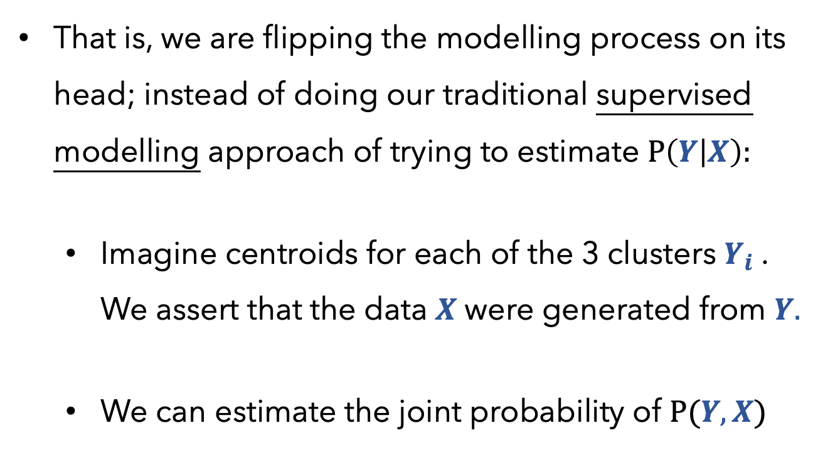
Clustering
k-Means example:
That is, we are flipping the modelling process on its head; instead of doing our traditional supervised modelling approach of trying to estimate $P\left(Y | X\right):$
Imagine centroids for each of the 3 clusters $Y_{i}$. We assert that the data $X$were generated from $Y.$
We can estimate the joint probability of $P(Y,X)$
1
3
2
Visual Representation

Slide 44
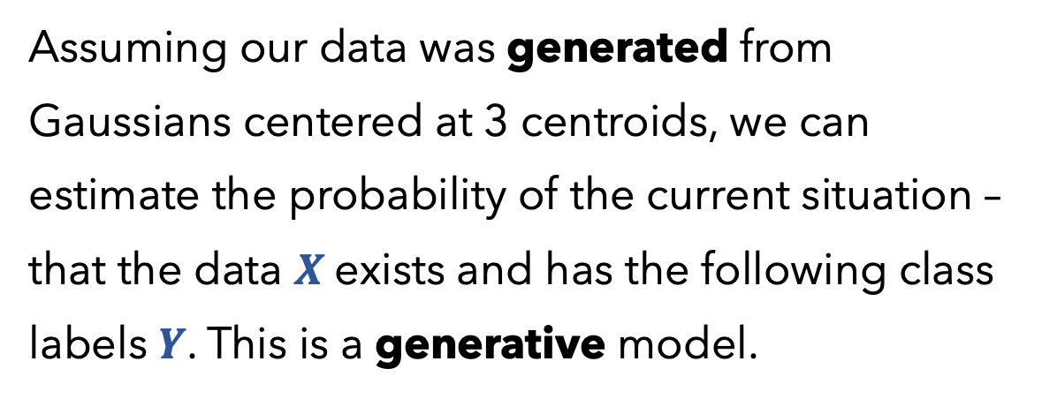

Clustering
k-Means example:
That is, we are flipping the modelling process on its head; instead of doing our traditional supervised modelling approach of trying to estimate $P(Y|X)$
Imagine centroids for each of the 3 clusters $Y_{i}$. We assert that the data $X$were generated from $Y.$
We can estimate the joint probability of $P(Y,X)$
Assuming our data was generated from Gaussians centered at 3 centroids, we can estimate the probability of the current situation – that the data $X$exists and has the following class labels $Y$. This is a generative model.
1
3
2
Visual Representation

Slide 45
Clustering
k-Means example:
That is, we are flipping the modelling process on its head; instead of doing our traditional supervised modelling approach of trying to estimate $P(Y|X)$
Imagine centroids for each of the 3 clusters $Y_{i}$. We assert that the data $X$were generated from $Y.$
We can estimate the joint probability of $P(Y,X)$
1
Generative models explicitly model the actual distribution of each class (e.g., data and its cluster assignments).
3
2
Visual Representation

Slide 46
Clustering
k-Means example:
That is, we are flipping the modelling process on its head; instead of doing our traditional supervised modelling approach of trying to estimate $P\left(Y | X\right):$
Imagine centroids for each of the 3 clusters $Y_{i}$. We assert that the data $X$were generated from $Y.$
We can estimate the joint probability of $P(Y,X)$
1
3
2
Visual Representation

Slide 47
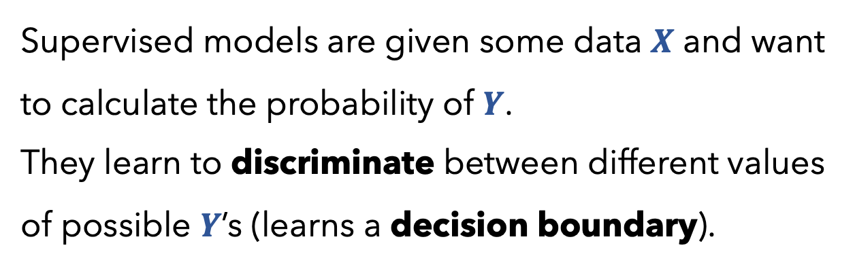

Clustering
k-Means example:
That is, we are flipping the modelling process on its head; instead of doing our traditional supervised modelling approach of trying to estimate $P(Y|X)$:
Imagine centroids for each of the 3 clusters $Y_{i}$. We assert that the data $X$were generated from $Y.$
We can estimate the joint probability of $P(Y,X)$
1
Supervised models are given some data $X$ and want to calculate the probability of $Y$.
They learn to discriminate between different values of possible $Y$’s (learns a decision boundary).
3
2
Visual Representation

Slide 48
Supervised vs
Unsupervised
Regression vs Classification
Parametric vs
Non-Parametric
Generative vs Discriminative
Linear Regression
Logistic Regression
k-NN
Decision Tree
PCA
Clustering
Supervised
Regression
Parametric
Discriminative
Supervised
Classification
Parametric
Discriminative
Supervised
either
Non-Parametric
Discriminative
Supervised
either
Non-Parametric
Discriminative
Unsupervised
neither
Non-Parametric
neither
Unsupervised
neither
Non-Parametric
Generative

Slide 49
Supervised vs
Unsupervised
Regression vs Classification
Parametric vs
Non-Parametric
Generative vs Discriminative
Linear Regression
Logistic Regression
k-NN
Decision Tree
PCA
Clustering
Supervised
Regression
Parametric
Discriminative
Supervised
Classification
Parametric
Discriminative
Supervised
either
Non-Parametric
Discriminative
Particularly, k-Means is generative, as it can be seen as a special case of Gaussian Mixture Models
Supervised
either
Non-Parametric
Discriminative
Unsupervised
neither
Non-Parametric
neither
Unsupervised
neither
Non-Parametric
Generative

Slide 50

Supervised vs
Unsupervised
Regression vs Classification
Parametric vs
Non-Parametric
Generative vs Discriminative
Linear Regression
Logistic Regression
k-NN
Decision Tree
PCA
Clustering
Supervised
Regression
Parametric
Discriminative
Given training $X$, learns to discriminate between possible $Y$ values (quantitative)
Supervised
Classification
Parametric
Discriminative
Supervised
either
Non-Parametric
Discriminative
Supervised
either
Non-Parametric
Discriminative
Unsupervised
neither
Non-Parametric
neither
Unsupervised
neither
Non-Parametric
Generative

Slide 51
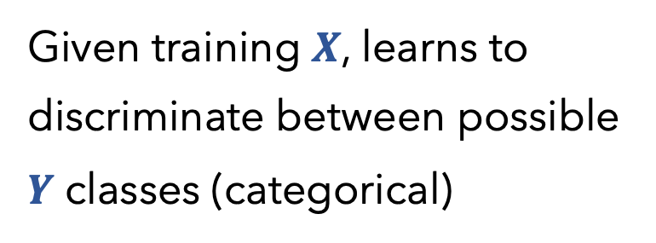
Supervised vs
Unsupervised
Regression vs Classification
Parametric vs
Non-Parametric
Generative vs Discriminative
Linear Regression
Logistic Regression
k-NN
Decision Tree
PCA
Clustering
Supervised
Regression
Parametric
Discriminative
Supervised
Classification
Parametric
Discriminative
Given training $X$, learns to discriminate between possible $Y$ classes (categorical)
Supervised
either
Non-Parametric
Discriminative
Supervised
either
Non-Parametric
Discriminative
Unsupervised
neither
Non-Parametric
neither
Unsupervised
neither
Non-Parametric
Generative

Slide 52
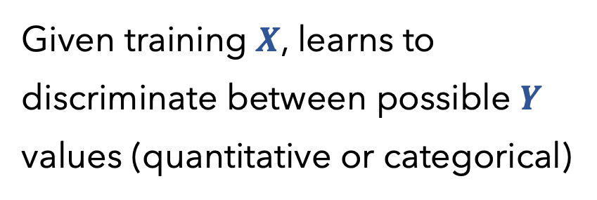
Supervised vs
Unsupervised
Regression vs Classification
Parametric vs
Non-Parametric
Generative vs Discriminative
Linear Regression
Logistic Regression
k-NN
Decision Tree
PCA
Clustering
Supervised
Regression
Parametric
Discriminative
Supervised
Classification
Parametric
Discriminative
Supervised
either
Non-Parametric
Discriminative
Given training $X$, learns to discriminate between possible $Y$ values (quantitative or categorical)
Supervised
either
Non-Parametric
Discriminative
Unsupervised
neither
Non-Parametric
neither
Unsupervised
neither
Non-Parametric
Generative

Slide 53
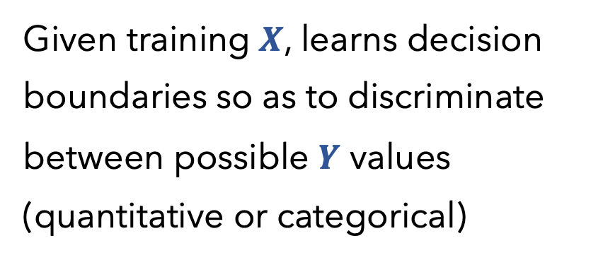
Supervised vs
Unsupervised
Regression vs Classification
Parametric vs
Non-Parametric
Generative vs Discriminative
Linear Regression
Logistic Regression
k-NN
Decision Tree
PCA
Clustering
Supervised
Regression
Parametric
Discriminative
Supervised
Classification
Parametric
Discriminative
Supervised
either
Non-Parametric
Discriminative
Given training $X$, learns decision boundaries so as to discriminate between possible $Y$ values (quantitative or categorical)
Non-Parametric
Supervised
either
Discriminative
Unsupervised
neither
Non-Parametric
neither
Unsupervised
neither
Non-Parametric
Generative

Slide 54
Supervised vs
Unsupervised
Regression vs Classification
Parametric vs
Non-Parametric
Generative vs Discriminative
Linear Regression
Logistic Regression
k-NN
Decision Tree
PCA
Clustering
Supervised
Regression
Parametric
Discriminative
Supervised
Classification
Parametric
Discriminative
Supervised
either
Non-Parametric
Discriminative
Supervised
either
Non-Parametric
Discriminative
Unsupervised
neither
Non-Parametric
neither
PCA is a process, not a model, so it doesn’t make sense to consider it as a Discriminate or Generative model
Unsupervised
neither
Non-Parametric
Generative

Slide 55
Supervised vs
Unsupervised
Regression vs Classification
Parametric vs
Non-Parametric
Generative vs Discriminative
Linear Regression
Logistic Regression
k-NN
Decision Tree
PCA
Clustering
Supervised
Regression
Parametric
Discriminative
Supervised
Classification
Parametric
Discriminative
Supervised
either
Non-Parametric
Discriminative
Supervised
either
Non-Parametric
Discriminative
Unsupervised
neither
Non-Parametric
neither
Unsupervised
neither
Non-Parametric
Generative

Slide 56
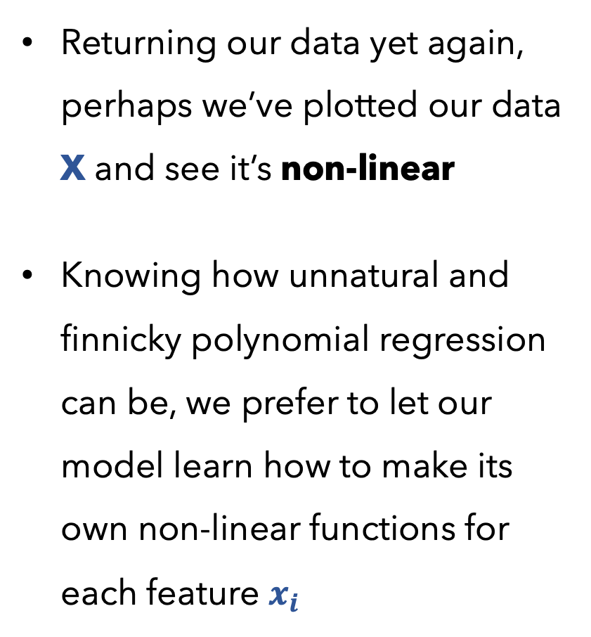
X
Y
Returning our data yet again, perhaps we’ve plotted our data X and see it’s non-linear
Knowing how unnatural and finnicky polynomial regression can be, we prefer to let our model learn how to make its own non-linear functions for each feature $x_{i}$
Age
Play
Rainy
Temp
22
29
31
23
37
41
29
21
30
N
Y
N
Y
N
Y
Y
N
Y
Y
N
N
N
Y
N
Y
N
N
91
89
56
71
72
83
97
64
68

Slide 57
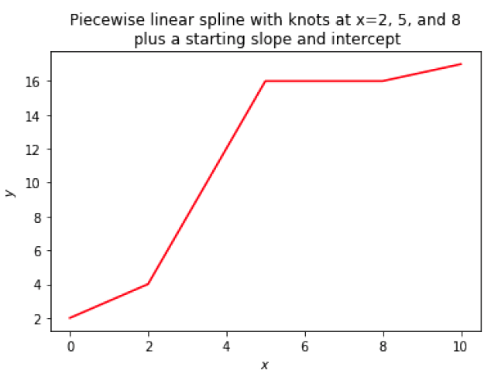
Generalized Additive Models (GAMs)
Refresher:
Not our data, but imagine it’s plotting age vs temp:

Slide 58
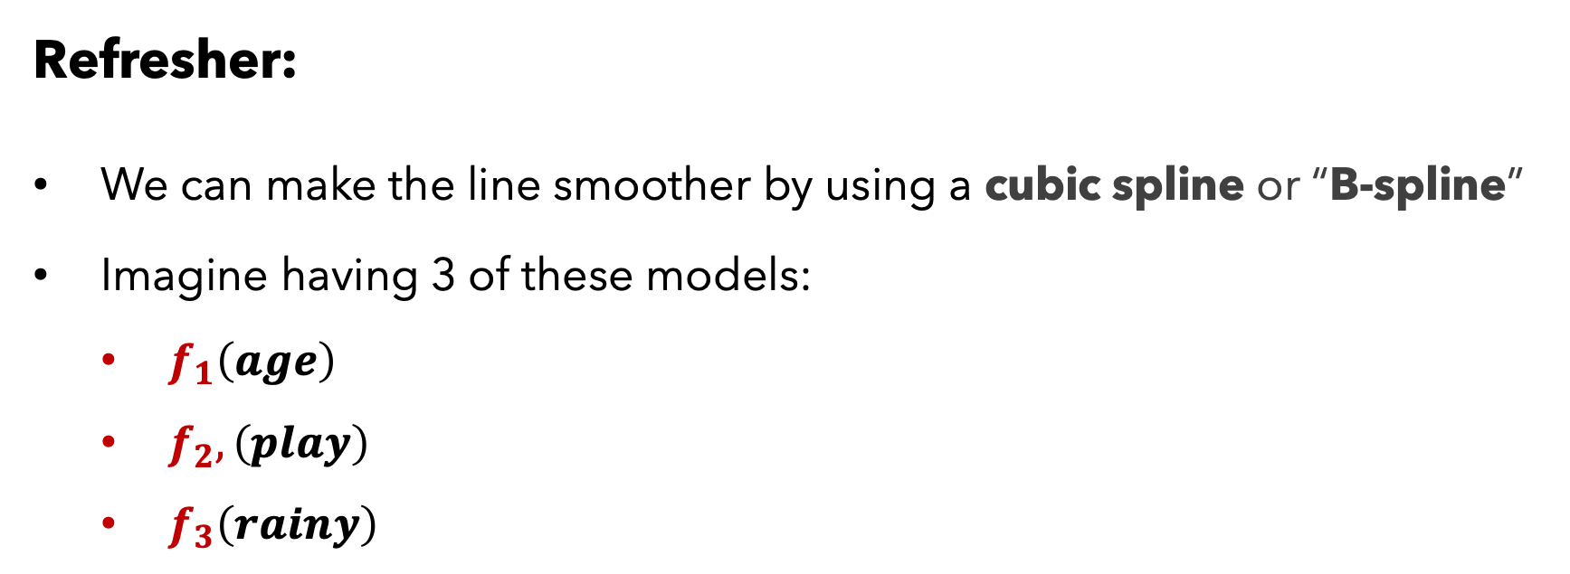

Generalized Additive Models (GAMs)
Refresher:
We can make the line smoother by using a cubic spline or “B-spline”
Imagine having 3 of these models:
$f_{1}\left(age\right)$
$f_{2},\left(play\right)$
$f_{3}\left(rainy\right)$
Not our data, but imagine it’s plotting age vs Temp:
We can model Temp as:
$$\text{Temp}=β_{0}+f_{1}\left(age\right)+f_{2}\left(play\right)+f_{3}\left(rainy\right)$$

Slide 59
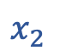
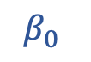
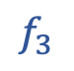



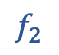
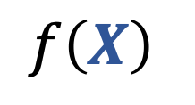



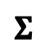

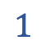
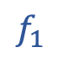
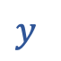



Generalized Additive Models (GAMs)
Y
91
$$y$$
$$Σ$$
$$y$$
$$β_{0}$$
$$1$$
$$1$$
$$1$$
$$f\left(X\right)$$
$$f_{1}$$
$$f_{2}$$
$$f_{3}$$
$$y=β_{0}+f_{1}\left(age\right)+f_{2}\left(play\right)+f_{3}\left(rainy\right)$$
$$1$$
$$1$$
$$1$$
22
N
Y
$$x_{1}$$
$$x_{2}$$
$$x_{3}$$
X
$$x_{1}$$
$$x_{2}$$
$$x_{3}$$
Graphically (NN format)
High-level
Mathematically

Slide 60

Generalized Additive Models (GAMs)
Y
It is called an additive model because we calculate a separate $f_{i}$ for each $x_{i}$ , and then add together all of their contributions.
91
$$y$$
$$Σ$$
$$y$$
$$β_{0}$$
$$1$$
$$1$$
$$1$$
$$f\left(X\right)$$
$$f_{1}$$
$$f_{2}$$
$$f_{3}$$
$$y=β_{0}+f_{1}\left(age\right)+f_{2}\left(play\right)+f_{3}\left(rainy\right)$$
$$1$$
$$1$$
$$1$$
22
N
Y
$$x_{1}$$
$$x_{2}$$
$$x_{3}$$
X
$$x_{1}$$
$$x_{2}$$
$$x_{3}$$
Graphically (NN format)
High-level
Mathematically

Slide 61

Generalized Additive Models (GAMs)
Y
It is called an additive model because we calculate a separate $f_{i}$ for each $x_{i}$ , and then add together all of their contributions.
91
$$y$$
$$Σ$$
$$y$$
$$β_{0}$$
$$1$$
$$1$$
$$1$$
$$f\left(X\right)$$
$$f_{1}$$
$$f_{2}$$
$$f_{3}$$
$$y=β_{0}+f_{1}\left(age\right)+f_{2}\left(play\right)+f_{3}\left(rainy\right)$$
$$1$$
$$1$$
$$1$$
$f_{i}$ doesn’t have to be a spline; can be any regression model
22
N
Y
$$x_{1}$$
$$x_{2}$$
$$x_{3}$$
X
$$x_{1}$$
$$x_{2}$$
$$x_{3}$$
Graphically (NN format)
High-level
Mathematically

Slide 62


Generalized Additive Models (GAMs)
PROS
CONS
Fits a non-linear function $f_{i}$ to each feature $x_{i}$
Much easier than guessing polynomial terms and multinomial interaction terms.
Model is additive, allowing us to exam the effects of each $x_{i}$on $y$ by holding the other features $x_{j≠i}$constant
The smoothness is easy to adjust
Restricted to being additive; important interactions may not be captured
Providing interactions via $f_{1}\left(age, rainy\right)$ can only capture so much, a la multinomial interaction terms

Slide 63
Supervised vs
Unsupervised
Regression vs Classification
Parametric vs
Non-Parametric
Generative vs Discriminative
Linear Regression
Logistic Regression
k-NN
Decision Tree
PCA
Clustering
GAMs
Supervised
Regression
Parametric
Discriminative
Supervised
Classification
Parametric
Discriminative
Supervised
either
Non-Parametric
Discriminative
Supervised
either
Non-Parametric
Discriminative
Unsupervised
neither
Non-Parametric
neither
Unsupervised
neither
Non-Parametric
Generative
Supervised
either
Parametric
Discriminative

Slide 64
X
Y
Returning our data yet again, perhaps we’ve plotted our data X and see it’s non-linear
We further suspect that there are complex interactions that cannot be represented by polynomial regression and GAMs
We just want great results and don’t care about interpretability
Age
Temp
Rainy
Play
22
29
31
23
37
41
29
21
30
91
89
56
71
72
83
97
64
68
Y
N
N
N
Y
N
Y
N
N
N
Y
N
Y
N
Y
Y
N
Y

Slide 65






Feed-Forward Neural Network
Y
N
$$y$$
$$y=\frac{1}{1+e^{−(b_{0}+b_{1}h_{1}+b_{2}h_{2})}}=σ(β^{2}H)$$
$$f\left(X\right)$$
$$h_{i}=\frac{1}{1+e^{−(b_{0}+b_{1}x_{1}+b_{2}x_{2}\text{+} b_{3}x_{3})}}=σ(β^{1}X)$$
X
22
N
Y
$$x_{1}$$
$$x_{2}$$
$$x_{3}$$
High-level
Mathematically

Slide 66

Feed-Forward Neural Network
Y
N
$$y$$
$$y=\frac{1}{1+e^{−(b_{0}+b_{1}h_{1}+b_{2}h_{2})}}=σ(β^{2}H)$$
$$f\left(X\right)$$
$$h_{i}=\frac{1}{1+e^{−(b_{0}+b_{1}x_{1}+b_{2}x_{2}\text{+} b_{3}x_{3})}}=σ(β^{1}X)$$
NOTE: a Neural Network can be viewed as a function $f\left(X\right)$, just like all of our past models
X
22
N
Y
$$x_{1}$$
$$x_{2}$$
$$x_{3}$$
High-level
Mathematically

Slide 67


















Feed-Forward Neural Network
General Notes:
It’s a fully connected network
Every
Every
Parameters $θ=\{β, O\}$ (weights)
$$y$$
$$σ(Σ)$$
$$o_{1}^{1}$$
$$o_{2}^{1}$$
is a weight, which is multiplied by its input
$$h_{1}$$
$$σ(Σ)$$
$$h_{2}$$
$$σ(Σ)$$
is a scalar value
$$b_{1}^{1}$$
$$b_{2}^{2}$$
$$b_{3}^{2}$$
$$b_{1}^{2}$$
$$b_{3}^{1}$$
$$b_{2}^{1}$$
$$x_{1}$$
$$x_{2}$$
$$x_{3}$$
Graphically (NN format)

Slide 68

Feed-Forward Neural Network
General Notes:
It’s a fully connected network
Every
Every
Parameters $θ=\{β, O\}$ (weights)
$$y$$
$$σ(Σ)$$
$$o_{1}^{1}$$
$$o_{2}^{1}$$
is a weight, which is multiplied by its input
$$h_{1}$$
$$σ(Σ)$$
$$h_{2}$$
$$σ(Σ)$$
is a scalar value
$$b_{1}^{1}$$
$$b_{2}^{2}$$
$$b_{3}^{2}$$
$$b_{1}^{2}$$
$$b_{3}^{1}$$
$$b_{2}^{1}$$
Input layer
$$x_{1}$$
$$x_{2}$$
$$x_{3}$$
Graphically (NN format)

Slide 69
Feed-Forward Neural Network
General Notes:
It’s a fully connected network
Every
Every
Parameters $θ=\{β, O\}$ (weights)
$$y$$
$$σ(Σ)$$
$$o_{1}^{1}$$
$$o_{2}^{1}$$
is a weight, which is multiplied by its input
?
$$h_{1}$$
$$σ(Σ)$$
$$h_{2}$$
$$σ(Σ)$$
is a scalar value
$$b_{1}^{1}$$
$$b_{2}^{2}$$
$$b_{3}^{2}$$
$$b_{1}^{2}$$
$$b_{3}^{1}$$
$$b_{2}^{1}$$
$$x_{1}$$
$$x_{2}$$
$$x_{3}$$
Graphically (NN format)

Slide 70
Feed-Forward Neural Network
General Notes:
It’s a fully connected network
Every
Every
Parameters $θ=\{β, O\}$ (weights)
$$y$$
$$σ(Σ)$$
$$o_{1}^{1}$$
$$o_{2}^{1}$$
is a weight, which is multiplied by its input
Hidden layer
$$h_{1}$$
$$σ(Σ)$$
$$h_{2}$$
$$σ(Σ)$$
is a scalar value
$$b_{1}^{1}$$
$$b_{2}^{2}$$
$$b_{3}^{2}$$
$$b_{1}^{2}$$
$$b_{3}^{1}$$
$$b_{2}^{1}$$
$$x_{1}$$
$$x_{2}$$
$$x_{3}$$
Graphically (NN format)

Slide 71
Feed-Forward Neural Network
General Notes:
It’s a fully connected network
Every
Every
Parameters $θ=\{β, O\}$ (weights)
Output layer
$$y$$
$$σ(Σ)$$
$$o_{1}^{1}$$
$$o_{2}^{1}$$
is a weight, which is multiplied by its input
$$h_{1}$$
$$σ(Σ)$$
$$h_{2}$$
$$σ(Σ)$$
is a scalar value
$$b_{1}^{1}$$
$$b_{2}^{2}$$
$$b_{3}^{2}$$
$$b_{1}^{2}$$
$$b_{3}^{1}$$
$$b_{2}^{1}$$
$$x_{1}$$
$$x_{2}$$
$$x_{3}$$
Graphically (NN format)

Slide 72
Feed-Forward Neural Network
General Notes:
It’s a fully connected network
Every
Every
Parameters $θ=\{β, O\}$ (weights)
$$y$$
$$σ(Σ)$$
$$o_{1}^{1}$$
$$o_{2}^{1}$$
is a weight, which is multiplied by its input
$$h_{1}$$
$$σ(Σ)$$
$$h_{2}$$
$$σ(Σ)$$
is a scalar value
$$b_{1}^{1}$$
$$b_{2}^{2}$$
$$b_{3}^{2}$$
$$b_{1}^{2}$$
$$b_{3}^{1}$$
$$b_{2}^{1}$$
$$x_{1}$$
$$x_{2}$$
$$x_{3}$$
Graphically (NN format)

Slide 73
Feed-Forward Neural Network
General Notes:
It’s a fully connected network
Every
Every
Parameters $θ=\{β, O\}$ (weights)
$$y$$
$$σ(Σ)$$
$$o_{1}^{1}$$
$$o_{2}^{1}$$
is a weight, which is multiplied by its input
Every
, except for
$$h_{1}$$
$$σ(Σ)$$
$$h_{2}$$
$$σ(Σ)$$
the input layer’s, is called an activation function.
They take input(s), apply some aggregate operation(s) -- often a non-linear transformation -- and yield a scalar value.
is a scalar value
$$b_{1}^{1}$$
$$b_{2}^{2}$$
$$b_{3}^{2}$$
$$b_{1}^{2}$$
$$b_{3}^{1}$$
$$b_{2}^{1}$$
$$x_{1}$$
$$x_{2}$$
$$x_{3}$$
Graphically (NN format)

Slide 74

Feed-Forward Neural Network
General Notes:
It’s a fully connected network
Every
Every
Parameters $θ=\{β, O\}$ (weights)
$$y$$
$$σ(Σ)$$
$$o_{1}^{1}$$
$$o_{2}^{1}$$
is a weight, which is multiplied by its input
Every
, except for
$$h_{1}$$
$$σ(Σ)$$
$$h_{2}$$
$$σ(Σ)$$
the input layer’s, is called an activation function.
The sigmoid function $σ$ is a common choice and is equivalent to performing logistic regression on its given inputs.
is a scalar value
$$b_{1}^{1}$$
$$b_{2}^{2}$$
$$b_{3}^{2}$$
$$b_{1}^{2}$$
$$b_{3}^{1}$$
$$b_{2}^{1}$$
$$x_{1}$$
$$x_{2}$$
$$x_{3}$$
Graphically (NN format)

Slide 75
Feed-Forward Neural Network
General Notes:
It’s a fully connected network
Every
Every
Parameters $θ=\{β, O\}$ (weights)
$$y$$
$$σ(Σ)$$
$$o_{1}^{1}$$
$$o_{2}^{1}$$
is a weight, which is multiplied by its input
Every
, except for
$$h_{1}$$
$$σ(Σ)$$
$$h_{2}$$
$$σ(Σ)$$
the input layer’s, is called an activation function.
Thus, neural nets can be viewed as being a fully-connected set of logistic regressions, oftentimes stacked (multiple hidden layers)
is a scalar value
$$b_{1}^{1}$$
$$b_{2}^{2}$$
$$b_{3}^{2}$$
$$b_{1}^{2}$$
$$b_{3}^{1}$$
$$b_{2}^{1}$$
$$x_{1}$$
$$x_{2}$$
$$x_{3}$$
Graphically (NN format)

Slide 76
Feed-Forward Neural Network
Training:
Q1
$$y$$
$$σ(Σ)$$
How do we train a neural network?
$$o_{1}^{1}$$
$$o_{2}^{1}$$
$$h_{1}$$
$$σ(Σ)$$
$$h_{2}$$
$$σ(Σ)$$
$$b_{1}^{1}$$
$$b_{2}^{2}$$
$$b_{3}^{2}$$
$$b_{1}^{2}$$
$$b_{3}^{1}$$
$$b_{2}^{1}$$
$$x_{1}$$
$$x_{2}$$
$$x_{3}$$
Graphically (NN format)

Slide 77
Feed-Forward Neural Network
Training:
Q1
$$y$$
$$σ(Σ)$$
How do we train a neural network?
$$o_{1}^{1}$$
$$o_{2}^{1}$$
A1
First, specify a cost function and an optimization algorithm, just like we did for our other supervised, parametric models
$$h_{1}$$
$$σ(Σ)$$
$$h_{2}$$
$$σ(Σ)$$
$$b_{1}^{1}$$
$$b_{2}^{2}$$
$$b_{3}^{2}$$
$$b_{1}^{2}$$
$$b_{3}^{1}$$
$$b_{2}^{1}$$
$$x_{1}$$
$$x_{2}$$
$$x_{3}$$
Graphically (NN format)

Slide 78


Feed-Forward Neural Network
Training:
$$y$$
$$σ(Σ)$$
Cost function
$$J\left(θ\right)=−[y\log{\hat{y}+}(1−y)\log{(1−\hat{y})]}$$
$$o_{1}^{1}$$
$$o_{2}^{1}$$
“Cross-Entropy” aka “Log loss”
$$h_{1}$$
$$σ(Σ)$$
$$h_{2}$$
$$σ(Σ)$$
Update the $θ$ via gradient descent
$$b_{1}^{1}$$
$$b_{2}^{2}$$
$$b_{3}^{2}$$
$$b_{1}^{2}$$
$$b_{3}^{1}$$
$$b_{2}^{1}$$
$$x_{1}$$
$$x_{2}$$
$$x_{3}$$
Graphically (NN format)

Slide 79


Feed-Forward Neural Network
Training:
$$y$$
$$σ(Σ)$$
Initialize $θ$with random values
Repeat until convergence:
Provide input $x_{i}$ to the network
Propagate the values through the network
Calculate the cost/loss
Calculate gradients via backpropagation
Update the weights (aka $θ$) via gradient descent
$$o_{1}^{1}$$
$$o_{2}^{1}$$
$$h_{1}$$
$$σ(Σ)$$
$$h_{2}$$
$$σ(Σ)$$
$$b_{1}^{1}$$
$$b_{2}^{2}$$
$$b_{3}^{2}$$
$$b_{1}^{2}$$
$$b_{3}^{1}$$
$$b_{2}^{1}$$
$$x_{1}$$
$$x_{2}$$
$$x_{3}$$
Graphically (NN format)

Slide 80




Feed-Forward Neural Network
Training:
$$y$$
$$σ(Σ)$$
Initialize $θ$with random values
Repeat until convergence:
Provide input $x_{i}$ to the network
Propagate the values through the network
Calculate the cost/loss via gradient descent
Update the weights (aka $θ$) via backpropagation
$$o_{1}^{1}$$
$$o_{2}^{1}$$
$$h_{1}$$
$$σ(Σ)$$
$$h_{2}$$
$$σ(Σ)$$
$$b_{1}^{1}$$
$$b_{2}^{2}$$
$$b_{3}^{2}$$
$$b_{1}^{2}$$
$$b_{3}^{1}$$
$$b_{2}^{1}$$
$$x_{1}$$
$$x_{2}$$
$$x_{3}$$
Graphically (NN format)

Slide 81








Feed-Forward Neural Network
Training:
$$y$$
$$σ(Σ)$$
Initialize $θ$with random values
Repeat until convergence:
Provide input $x_{i}$ to the network
Propagate the values through the network
Calculate the cost/loss via gradient descent
Update the weights (aka $θ$) via backpropagation
$$o_{1}^{1}$$
$$o_{2}^{1}$$
$$h_{1}$$
$$σ(Σ)$$
$$h_{2}$$
$$σ(Σ)$$
$$b_{1}^{1}$$
$$b_{2}^{2}$$
$$b_{3}^{2}$$
$$b_{1}^{2}$$
$$b_{3}^{1}$$
$$b_{2}^{1}$$
$$x_{1}$$
$$x_{2}$$
$$x_{3}$$
Graphically (NN format)

Slide 82
Feed-Forward Neural Network
Training:
$$y$$
$$σ(Σ)$$
Initialize $θ$with random values
Repeat until convergence:
Provide input $x_{i}$ to the network
Propagate the values through the network
Calculate the cost/loss via gradient descent
Update the weights (aka $θ$) via backpropagation
$$o_{1}^{1}$$
$$o_{2}^{1}$$
$$h_{1}$$
$$σ(Σ)$$
$$h_{2}$$
$$σ(Σ)$$
$$b_{1}^{1}$$
$$b_{2}^{2}$$
$$b_{3}^{2}$$
$$b_{1}^{2}$$
$$b_{3}^{1}$$
$$b_{2}^{1}$$
22
91
1
Graphically (NN format)

Slide 83
Feed-Forward Neural Network
Training:
$$y$$
$$σ(Σ)$$
Initialize $θ$with random values
Repeat until convergence:
Provide input $x_{i}$ to the network
Propagate the values through the network
Calculate the cost/loss via gradient descent
Update the weights (aka $θ$) via backpropagation
$$o_{1}^{1}$$
$$o_{2}^{1}$$
$$h_{1}$$
.6
$$h_{2}$$
.2
$$b_{1}^{1}$$
$$b_{2}^{2}$$
$$b_{3}^{2}$$
$$b_{1}^{2}$$
$$b_{3}^{1}$$
$$b_{2}^{1}$$
22
91
1
Graphically (NN format)

Slide 84
Feed-Forward Neural Network
Training:
$$y$$
0.4
Initialize $θ$with random values
Repeat until convergence:
Provide input $x_{i}$ to the network
Propagate the values through the network
Calculate the cost/loss via gradient descent
Update the weights (aka $θ$) via backpropagation
$$o_{1}^{1}$$
$$o_{2}^{1}$$
$$h_{1}$$
.6
$$h_{2}$$
.2
$$b_{1}^{1}$$
$$b_{2}^{2}$$
$$b_{3}^{2}$$
$$b_{1}^{2}$$
$$b_{3}^{1}$$
$$b_{2}^{1}$$
22
91
1
Graphically (NN format)

Slide 85

Feed-Forward Neural Network
Training:
$$J\left(θ\right)=−[y\log{\hat{y}+}(1−y)\log{(1−\hat{y})]}$$
$$y$$
0.4
Initialize $θ$with random values
Repeat until convergence:
Provide input $x_{i}$ to the network
Propagate the values through the network
Calculate the cost/loss
Calculate gradients via backpropagation
Update the weights (aka $θ$) via gradient descent
$$o_{1}^{1}$$
$$o_{2}^{1}$$
$$h_{1}$$
.6
$$h_{2}$$
.2
$$b_{1}^{1}$$
$$b_{2}^{2}$$
$$b_{3}^{2}$$
$$b_{1}^{2}$$
$$b_{3}^{1}$$
$$b_{2}^{1}$$
22
91
1
Graphically (NN format)

Slide 86

Feed-Forward Neural Network
Training:
$$J\left(θ\right)=−[0+ (1−0)\log{(1−0.4)]}$$
$$y$$
0.4
Initialize $θ$with random values
Repeat until convergence:
Provide input $x_{i}$ to the network
Propagate the values through the network
Calculate the cost/loss
Calculate gradients via backpropagation
Update the weights (aka $θ$) via gradient descent
$$o_{1}^{1}$$
$$o_{2}^{1}$$
$$h_{1}$$
.6
$$h_{2}$$
.2
$$b_{1}^{1}$$
$$b_{2}^{2}$$
$$b_{3}^{2}$$
$$b_{1}^{2}$$
$$b_{3}^{1}$$
$$b_{2}^{1}$$
22
91
1
Graphically (NN format)

Slide 87

Feed-Forward Neural Network
Training:
$$J\left(θ\right)=−[0+ (1−0)\log{(0.6)]}$$
$$y$$
0.4
Initialize $θ$with random values
Repeat until convergence:
Provide input $x_{i}$ to the network
Propagate the values through the network
Calculate the cost/loss
Calculate gradients via backpropagation
Update the weights (aka $θ$) via gradient descent
$$o_{1}^{1}$$
$$o_{2}^{1}$$
$$h_{1}$$
.6
$$h_{2}$$
.2
$$b_{1}^{1}$$
$$b_{2}^{2}$$
$$b_{3}^{2}$$
$$b_{1}^{2}$$
$$b_{3}^{1}$$
$$b_{2}^{1}$$
22
91
1
Graphically (NN format)

Slide 88

Feed-Forward Neural Network
Training:
$$J\left(θ\right)=−\log{(0.6)}$$
$$y$$
0.4
Initialize $θ$with random values
Repeat until convergence:
Provide input $x_{i}$ to the network
Propagate the values through the network
Calculate the cost/loss
Calculate gradients via backpropagation
Update the weights (aka $θ$) via gradient descent
$$o_{1}^{1}$$
$$o_{2}^{1}$$
$$h_{1}$$
.6
$$h_{2}$$
.2
$$b_{1}^{1}$$
$$b_{2}^{2}$$
$$b_{3}^{2}$$
$$b_{1}^{2}$$
$$b_{3}^{1}$$
$$b_{2}^{1}$$
22
91
1
Graphically (NN format)

Slide 89

Feed-Forward Neural Network
Training:
$$J\left(θ\right)=0.22$$
$$y$$
0.4
Initialize $θ$with random values
Repeat until convergence:
Provide input $x_{i}$ to the network
Propagate the values through the network
Calculate the cost/loss
Calculate gradients via backpropagation
Update the weights (aka $θ$) via gradient descent
$$o_{1}^{1}$$
$$o_{2}^{1}$$
$$h_{1}$$
.6
$$h_{2}$$
.2
$$b_{1}^{1}$$
$$b_{2}^{2}$$
$$b_{3}^{2}$$
$$b_{1}^{2}$$
$$b_{3}^{1}$$
$$b_{2}^{1}$$
22
91
1
Graphically (NN format)

Slide 90


Feed-Forward Neural Network
Training:
$$J\left(θ\right)=0.22$$
$$y$$
0.4
Initialize $θ$with random values
$$∇_{2}^{2}$$
$$∇_{1}^{2}$$
$$o_{2}^{1}$$
Repeat until convergence:
Provide input $x_{i}$ to the network
Propagate the values through the network
Calculate the cost/loss
Calculate gradients via backpropagation
Update the weights (aka $θ$) via gradient descent
$$o_{1}^{1}$$
$$h_{1}$$
.6
$$h_{2}$$
.2
$$b_{1}^{1}$$
$$b_{2}^{2}$$
$$b_{3}^{2}$$
$$b_{1}^{2}$$
$$b_{3}^{1}$$
$$b_{2}^{1}$$
22
91
1
Graphically (NN format)

Slide 91








Feed-Forward Neural Network
Training:
$$J\left(θ\right)=0.22$$
$$y$$
0.4
Initialize $θ$with random values
Repeat until convergence:
Provide input $x_{i}$ to the network
Propagate the values through the network
Calculate the cost/loss
Calculate gradients via backpropagation
Update the weights (aka $θ$) via gradient descent
$$∇_{1}^{2}$$
$$∇_{2}^{2}$$
$$h_{1}$$
.6
$$h_{2}$$
.2
$$∇_{1}^{1}$$
$$∇_{2}^{1}$$
$$∇_{3}^{2}$$
$$b_{1}^{1}$$
$$∇_{1}^{2}$$
$$∇_{2}^{2}$$
$$∇_{3}^{1}$$
$$b_{3}^{2}$$
$$b_{1}^{2}$$
$$b_{2}^{2}$$
$$b_{2}^{1}$$
$$b_{3}^{1}$$
22
91
1
Graphically (NN format)

Slide 92








Feed-Forward Neural Network
Training:
$$J\left(θ\right)=0.22$$
$$y$$
$$σ(Σ)$$
Initialize $θ$with random values
Repeat until convergence:
Provide input $x_{i}$ to the network
Propagate the values through the network
Calculate the cost/loss
Calculate gradients via backpropagation
Update the weights (aka $θ$) via gradient descent
$$o_{1}^{1}$$
$$o_{2}^{1}$$
$$h_{1}$$
$$σ(Σ)$$
$$h_{2}$$
$$σ(Σ)$$
$$b_{1}^{1}$$
$$b_{2}^{2}$$
$$b_{3}^{2}$$
$$b_{1}^{2}$$
$$b_{3}^{1}$$
$$b_{2}^{1}$$
22
91
1
Graphically (NN format)

Slide 93

Feed-Forward Neural Network
Training:
$$J\left(θ\right)=0.22$$
$$y$$
$$σ(Σ)$$
Initialize $θ$with random values
Repeat until convergence:
Provide input $x_{i}$ to the network
Propagate the values through the network
Calculate the cost/loss
Calculate gradients via backpropagation
Update the weights (aka $θ$) via gradient descent
$$o_{1}^{1}$$
$$o_{2}^{1}$$
$$h_{1}$$
$$σ(Σ)$$
$$h_{2}$$
$$σ(Σ)$$
$$b_{1}^{1}$$
$$b_{2}^{2}$$
$$b_{3}^{2}$$
$$b_{1}^{2}$$
$$b_{3}^{1}$$
$$b_{2}^{1}$$
22
91
1
Graphically (NN format)

Slide 94

Feed-Forward Neural Network (and all other neural nets)
PROS
CONS
Fits many linear or non-linear activation functions $f_{i}$ to combinations of input $X$
Can model highly complex behavior
When designed well, can provide state-of-the-art results on most tasks
Incredible resources, libraries, and support
Sensitive to architecture choices and hyperparameters
Tricky to debug
Can be computationally expensive
Poor interpretability

Slide 95
Supervised vs
Unsupervised
Regression vs Classification
Parametric vs
Non-Parametric
Generative vs Discriminative
Linear Regression
Logistic Regression
k-NN
Decision Tree
PCA
Clustering
GAMs
Feed-Forward Net
Supervised
Regression
Parametric
Discriminative
Supervised
Classification
Parametric
Discriminative
Supervised
either
Non-Parametric
Discriminative
Supervised
either
Non-Parametric
Discriminative
Unsupervised
neither
Non-Parametric
neither
Unsupervised
neither
Non-Parametric
Generative
Supervised
either
Parametric
Discriminative
Supervised
either
Parametric
Discriminative

Slide 96




Supervised Models
IMPORTANT
When training any supervised model, be careful of overfitting your model
A good model should generalize well to unseen (i.e., testing) data
Consider adding regularization term $R\left(θ\right)$ to your cost function
Imposes a penalty based on your parameter values $θ$
L1 regularization:
$R\left(θ\right)$ = $\sum_{i=1}^{n}{|θ_{i}|}$
Prefers many small-weight values
L2 regularization:
$R\left(θ\right)$ = $\sum_{i=1}^{n}{θ_{i}^{2}}$
Prefers sparse weights (many 0’s)
Additionally, you can add dropout to Neural Networks

Slide 97
Supervised Models
IMPORTANT
When training any supervised model, wisely use your training data
A good model should generalize well to unseen (i.e., testing) data
Shuffle your training data and optionally bootstrap samples
Perform cross-validation

Slide 98



MLE vs MAP
So far, whenever we’ve discussed training a model, we’ve assumed our data was i.i.d. and we framed the problem as maximizing the similarity of the predictions and the gold truth by adjusting the parameters $θ$
e.g.
Q1
When training our model, how do we measure its $m$ predictions $\hat{y}$ ?
$$J\left(θ\right)=\frac{1}{2}\sum_{i=1}^{m}{{\left(\hat{y}−y\right)}^{2}}$$
A1
Cost function
“Least Squares”

Slide 99

MLE vs MAP
We were performing the maximum likelihood estimate
Def:
maximum likelihood estimate (MLE) asserts that we should choose $θ$ so as to maximize the likelihood of the observed data (i.e., our $\hat{y}$ should become as close to $y$ as possible)

Slide 100



MLE vs MAP
In other words, we were searching for ${\hat{θ}}_{MLE}$
Say we have the likelihood function $P(D|θ)$
$${\hat{θ}}_{MLE}={\text{argmax}}_{θ}P(D|θ)$$

Slide 101


MLE vs MAP
MAP stands for maximum a posteriori and is interested in calculating $P(θ|D)$
If we have knowledge about the prior distribution $P(θ)$, we can calculate:
$$P\left(θ | D\right)= \frac{P\left(D | θ\right)P\left(θ\right) }{P\left(X\right)}= ∝P\left(D | θ\right)P\left(θ\right)$$

Slide 102

MLE vs MAP
MAP stands for maximum a posteriori and is interested in calculating $P(θ|D)$
If we have knowledge about the prior distribution $P(θ)$, we can calculate:
$$P\left(θ | D\right)= \frac{P\left(D | θ\right)P\left(θ\right) }{P\left(X\right)}= ∝P\left(D | θ\right)P\left(θ\right)$$
$${\hat{θ}}_{MAP}={\text{argmax}}_{θ}P\left(D | θ\right)P\left(θ\right)$$

Slide 103

MLE vs MAP
MAP stands for maximum a posteriori and is interested in calculating $P(θ|D)$
If we have knowledge about the prior distribution $P(θ)$, we can calculate:
NOTE: If the prior $P\left(θ\right)$ is uniform (i.e., not Gaussian or any other distribution), then ${\hat{θ}}_{MAP}={\hat{θ}}_{MLE}$
$$P\left(θ | D\right)= \frac{P\left(D | θ\right)P\left(θ\right) }{P\left(X\right)}= ∝P\left(D | θ\right)P\left(θ\right)$$
Thus, MLE is a special case of MAP!
$${\hat{θ}}_{MAP}={\text{argmax}}_{θ}P\left(D | θ\right)P\left(θ\right)$$

Slide 104
CLOSING NOTE
The model ≠ the data ≠ the data’s representation
Many models can work well with data from different domains. The model restrictions concern your assumptions about the data, and what you’re trying to do with the data. The representation of the data can permit/limit the model’s ability to fit/learn the data.
Now let’s turn to the world of language data and useful models for it

